Slide 1



Crop and Fertilizer
Recommendation System
Machine Learning-based Agricultural Analysis
Presented by: ALI ABBAS

Slide 2

Learning Objectives
• Understand the importance of data-driven decision- making in agriculture.
• Learn how machine learning helps in crop and fertiliser recommendations.
• Explore data preprocessing, feature selection, and model training.
• Implement a predictive model using Python and scikit-learn.
• Improve agricultural efficiency by recommending suitable crops and fertilisers.
GOAL
Source :
www.freepik.com/

Slide 3
Tools and Technology used
Programming Language: Python
Libraries Used: NumPy, Pandas, Matplotlib, Seaborn
Machine Learning: Scikit-learn (DecisionTreeClassifier)
Data Processing: Label Encoding, Standard Scaling
IDE Used: Jupyter Notebook
Dataset: Crop Recommendation Dataset, Fertilizer Prediction Dataset

Slide 4
Methodology
Data Collection: Crop and fertilizer datasets.
Data Preprocessing: Handling missing values, and encoding categorical data.
Exploratory Data Analysis (EDA): Visualization of dataset trends.
Feature Engineering: Selecting relevant parameters (N, P, K, etc.).
Model Training: Using Decision Tree Classifier for predictions.
Evaluation & Testing: Checking accuracy and optimizing the model.
Final Prediction: Recommending the best crop and fertilizers based on input data.

Slide 5
Problem Statement:
Farmers often struggle to determine the best crop and fertilizer for their soil.
Soil properties such as Nitrogen (N), Phosphorus (P), Potassium (K), temperature, humidity, pH, and rainfall play a crucial role.
Incorrect crop selection leads to poor yield and financial losses.
A data-driven approach can assist farmers in making informed decisions.

Slide 6
Solution:
A machine learning-based recommendation system that suggests optimal crops and fertilizers based on soil properties.
The model takes N, P, K, temperature, humidity, pH, and rainfall as inputs.
Trained using DecisionTreeClassifier to classify the best crop and suitable fertilizer.
Provides accurate and personalized agricultural recommendations.

Slide 7
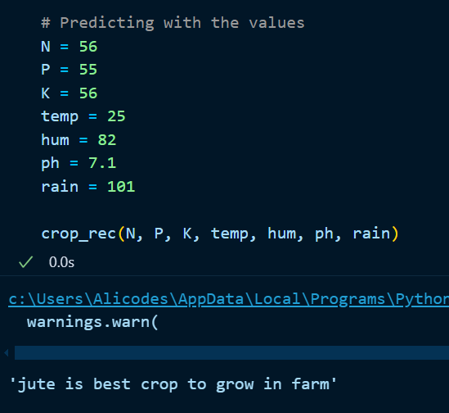
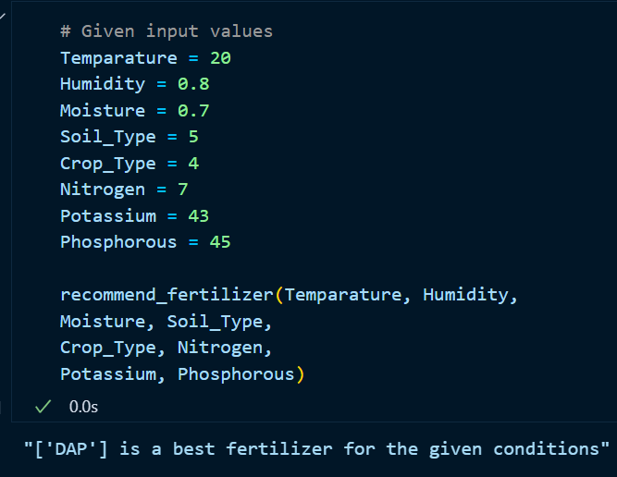
Screenshot of Output:

Slide 8
Conclusion:
Successfully built a crop and fertilizer recommendation system using machine learning.
Helps farmers make data-driven decisions to improve crop yield.
Reduces wastage of resources by suggesting appropriate fertilizers.
Future improvements:
Deploying the model as a web app or mobile app.
Enhancing the dataset for more accurate recommendations.
Exploring deep learning models for further improvements.

